Slide 1
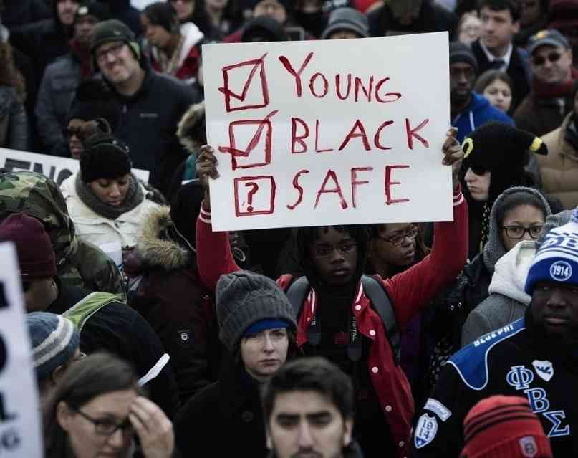
An Exploration on Police Brutality in the US and Its Effects on the African-American Community Giang Nguyen Yazan Khayata Madelyn Mathai Terry Mullin Srinivasan Raajagopal Daman Sandhu Svenja Telle

Slide 2

We collect data, create models, and interpret models which can then allow us to justify the world around us.
That justification implies a certain level of morality.
Utilitarian (greatest good for the greatest number) Deontological (Kantian-the right thing to do) or Egoism (self-interest)
Notes:
Utilitarian (greatest good for the greatest number) betterment of society Deontological (Kantian-the right thing to do) American Disabilities Act is an example of this
or Egoism (self-interest) Capitalism is an example of this

Slide 3
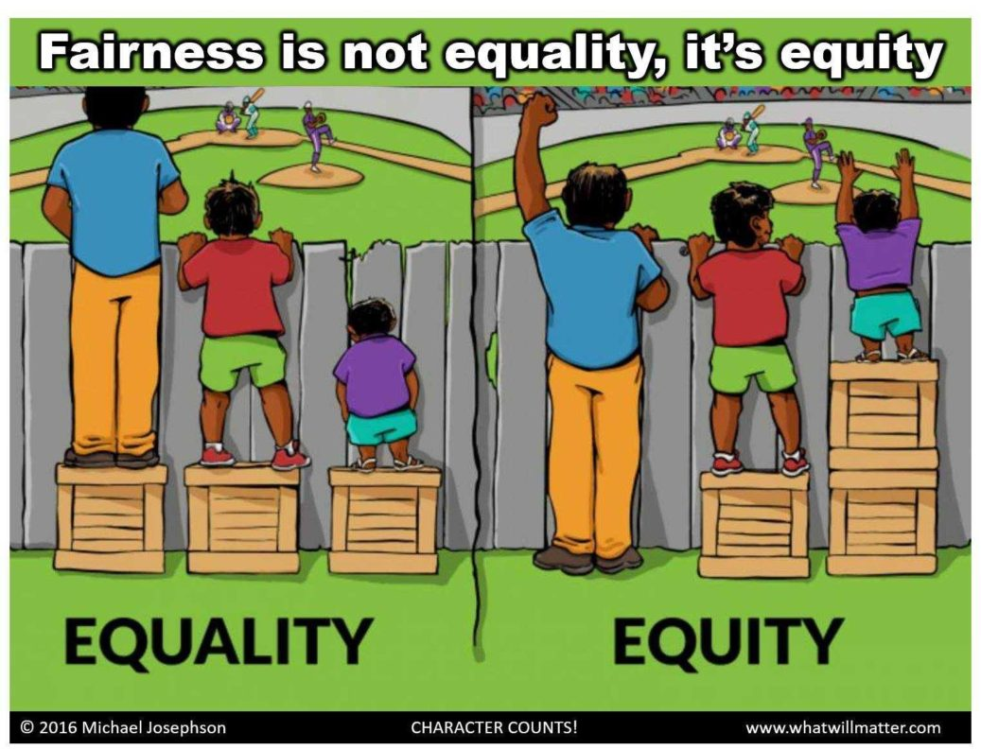
We decided the present-day conflict of equality vs. equity would be an ideal project for this class.
Equality is the idea where everyone is given an equal amount of resources, i.e., being “fair”. Utilitarian approach.
Equity is the idea where resources are given based on needs, an overall approach of looking at the grand scale of the situation. Deontological (Kantian) approach.

Slide 4

For our project, we related the difference between equality and equity using data on police violence against minorities.
We compared the race predicted by the model to the actual race in the dataset. (Accuracy of our model)
Our model can also look to see if being “armed” or being both “armed” and “fleeing” provides relatively the same results.
Thesis Statement: Police brutality disproportionally affects the African American community in the United States.
Null Hypothesis: Police brutality affects all races equally.

Slide 5

Raw dataset
Fatal Encounters
Source: fatalencounters.org
Number of records: 28,621
Number of columns imported: 21
Washington post shootings
Source: Washington Post
Number of records: 5,552
Number of columns imported: 14
State Demographic:
Source: KFF estimates based on the 2008-2019 American Community Survey, 1-Year Estimates
Number of records imported: 53

Slide 6

Database with tables and relationship
Service : AWS RDS
Endpoint : database-1.cukfyvhxl6ur.us-west-1.rds.amazonaws.com
Database : PostgreSQL
Tables :
State_demographic : Holds the statewise race details.
Fatal_encounter_org : Fatal Encounter details of each state
Shootings_washington_post : Shooting details of each state
Fatal_ec_w_demog : Fatal encounters joined with state demographics
Shootings_wp_w_demog : Shootings joined with state demographics

Slide 7
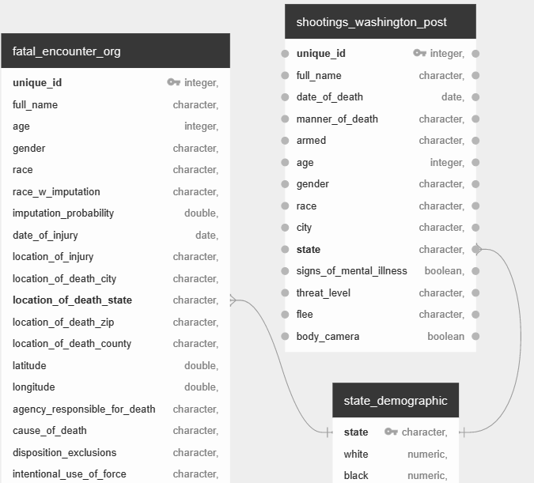
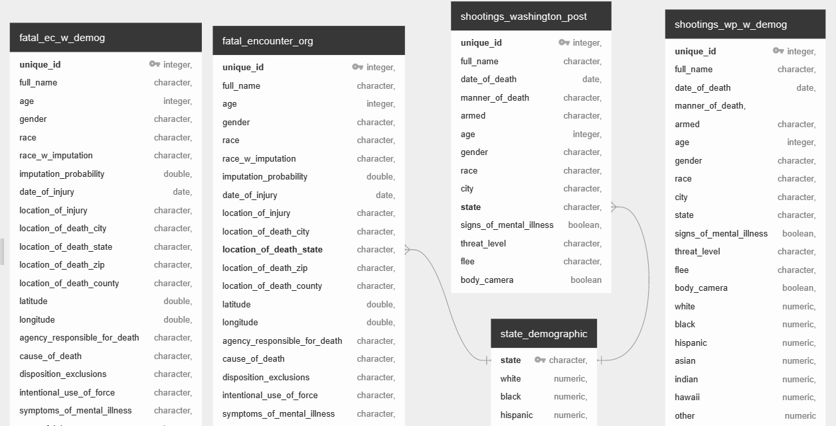
ERD
https://app.quickdatabasediagrams.com/#/d/ZZa7tm

Slide 8
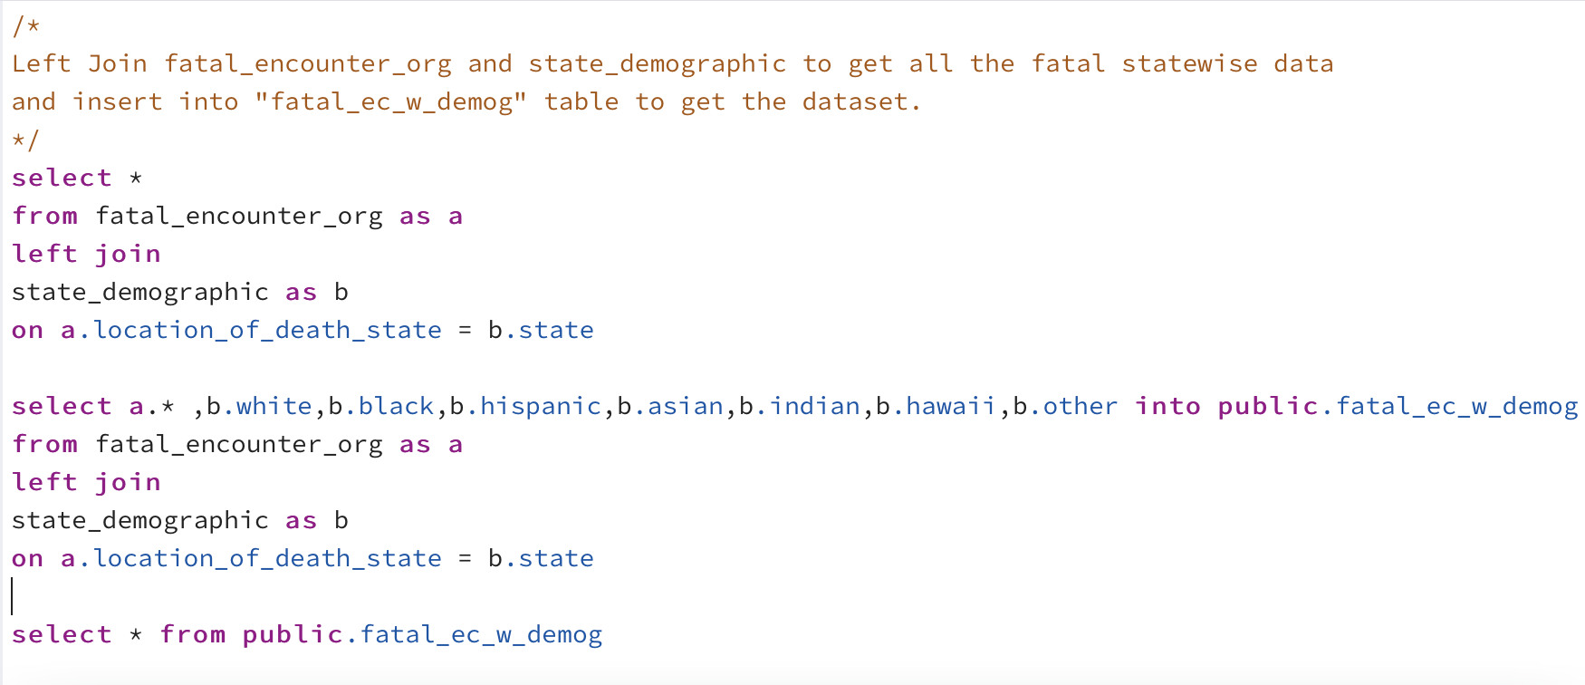
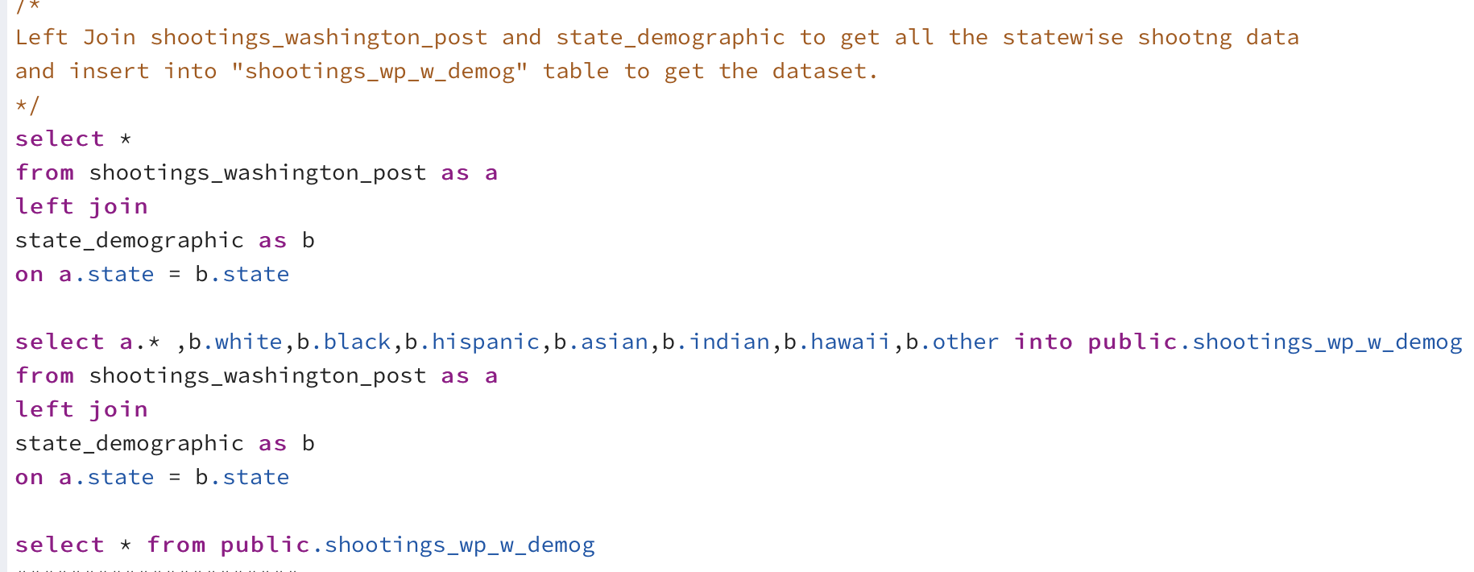
Code Snips
Select * from fatal_encounter_org as a
left join
state_demographic as b
on a.location_of_death_state = b.state

Slide 9
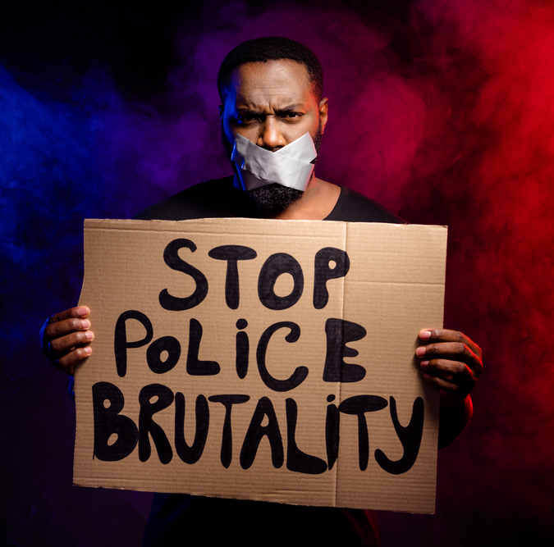
Tech stack
Cloud : AWS RDS
Database : PostgreSQL
Scripts : Pandas, SciKit-Learn
Tools : VSCode, Terminal, Tableau
Repository : Github

Slide 10
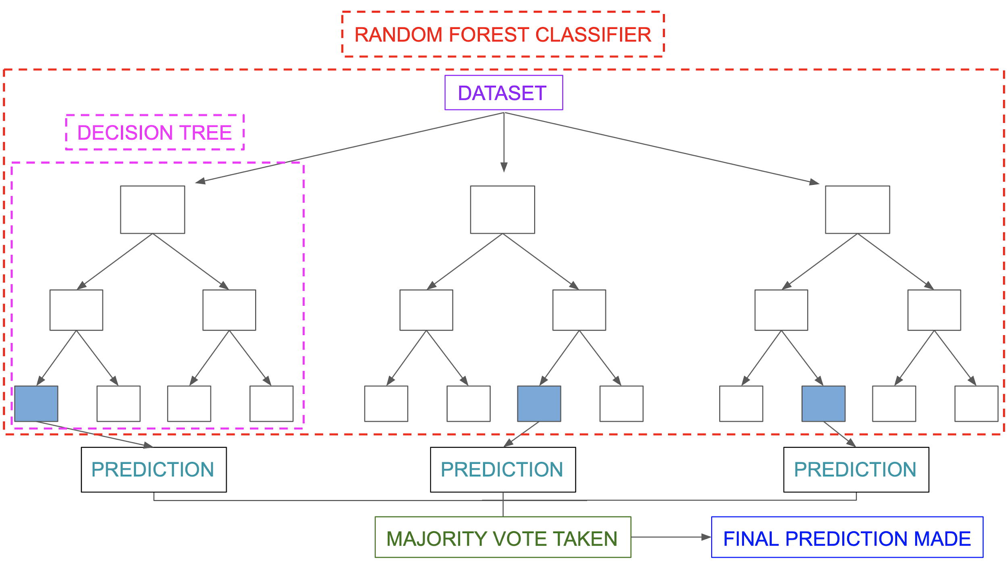
Learning algorithm
Learning Algorithm: Random Forest
Train-Test ratio split 70/30
97% F1 (Recall + Precision) Accuracy Score
Main Benefits:
Works nicely with non-linear data (ex: boolean/categorical)
Accounts for missing values and maintains data accuracy
Main Limitation:
Real-time predictions can cause slow and unproductive algorithms

Slide 11
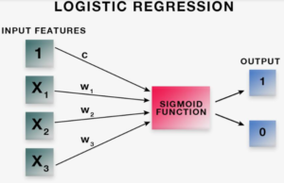
Machine learning model
Logistic Regression Model is used for binary classifications:
Sigmoid Function
If larger than or equal to 0.5 = 1
If smaller than 0.5 = 0
Classification of whether individuals were African American or not (1 - True, 0 - False)
Age, Gender, Flee, Threat Level, Armed, Body Camera, Signs of Mental Illness were input features, race, either 1 or 0 the output
Race, either 1 or 0, the output

Slide 12
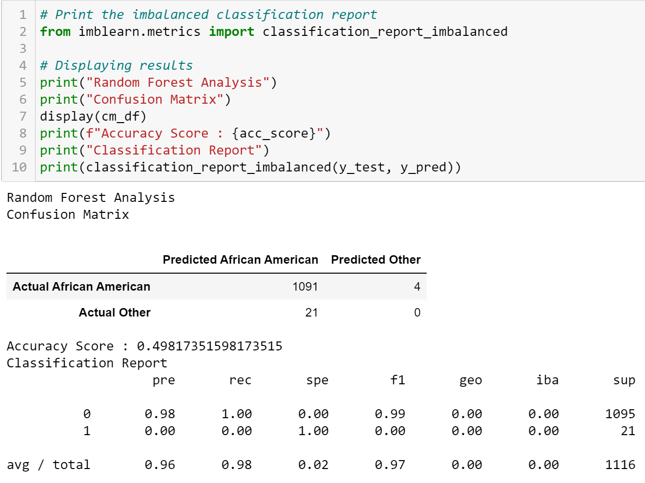
Machine learning findings
Accuracy Score .49817
Random Forest Analysis
49.8% Accuracy
Individual variables range from:
49% - 59%

Slide 13
Dashboard
Published in Tablaeu
Visualizations of findings of NLP model
Key Learnings:
Of those murdered by police, more African American victims tended to be fleeing.
African Americans also tended to be younger on average.
African Americans have a higher perceived threat level.
Despite having a higher perceived threat level, in instances of police brutality against African Americans, body cameras were more likely to be off.

Slide 14
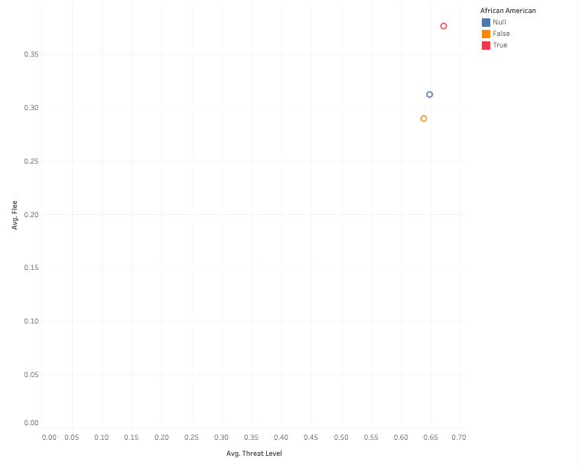
Results
.35
.30
.25
.20
.15
.10
.05
Avg. Flee
0 0.5 .10 .15 .20 .25 .30 .35 .40 .45 .50 .55 .60 .65 .70 .75
Avg. Threat Level

Slide 15
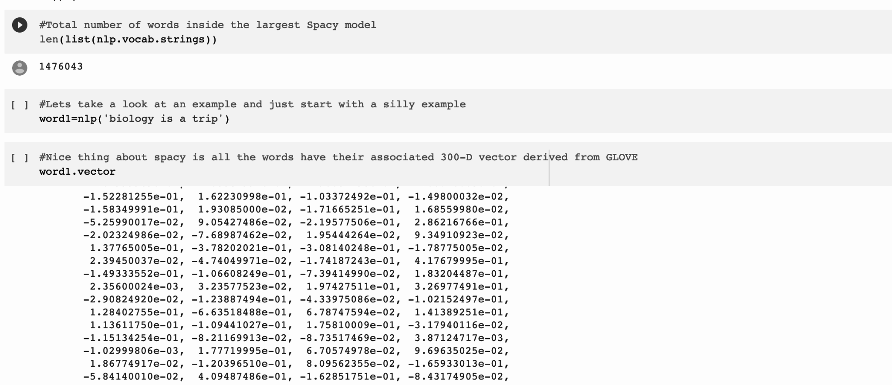
NLP - Artificial Intelligence with vector modeling
Word embedding model derived from GloVe (Global Vectors for Word Representation).
Vector representations for words using neural network models.
Training on aggregated global word co-occurrence matrix.
Output:
300-dimensional vectors / word.
linear substructures of the word vector space.
Model assumption:
ratios of word-word co-occurrence probabilities.
cosine similarity between word vectors.
measuring the linguistic or semantic similarity of corresponding words.

Slide 16
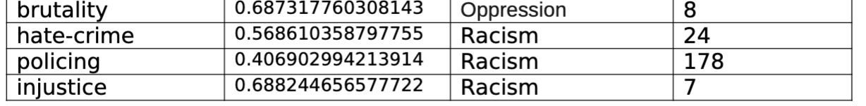
Application of the NLP model
Wordlist:
Brutality, hate-crime, policing, injustice, arrest report, arrest, black, african-american and mental health.
Generated top 300 similarity scores for each word.
Cosine Similarity Score
GloVe produces word vectors with a marked banded structure.
Score ranges from 0-1, measures the degree of similarity between two vectors.
The SpaCy library was used to measure cosine similarity.

Slide 17
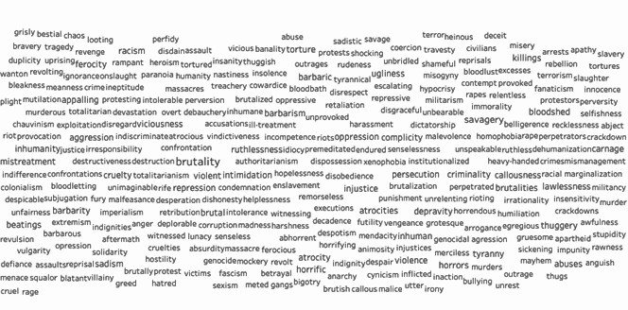
“Brutality” Similarity Scores

Slide 18
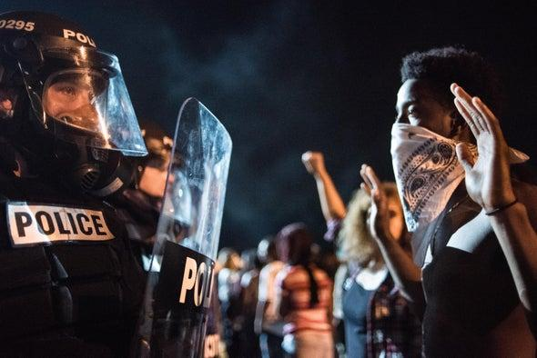
Thank You for LISTENING

